Slide 1
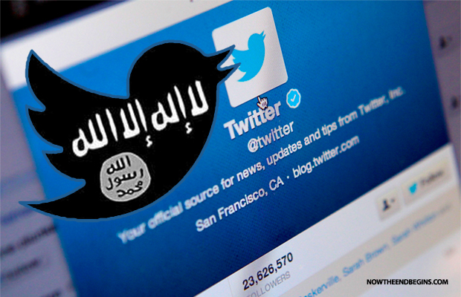
RADICALISATION ON SOCIAL MEDIA
Adam Hoffman
Ph.D Candidate
The Hebrew University of Jerusalem

Slide 2
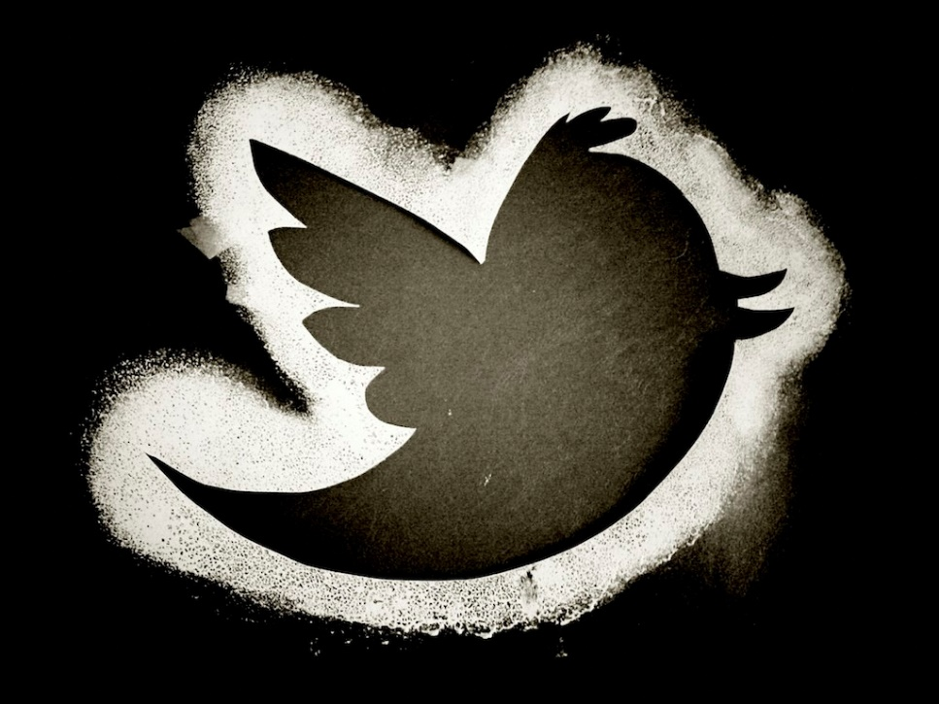
ISIS’ use of Social Media
“The high-quality videos, the online magazines, the use of social media, terrorist Twitter accounts - it’s all designed to target today’s young people online, in cyberspace.”
- President Obama, February 2015
Social media has become “the command-and-control networks of choice for terrorists.”
- Robert Hannigan, Director of GCHQ

Slide 3
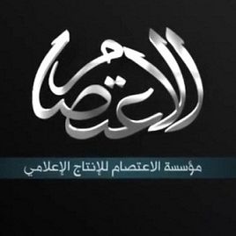



Official Media Outlets
Al Hayat Media Center:
Produces propaganda for Western audiences
Ajnad:
Produces nasheeds (Islamic songs) and video clips
Al Furqan, Al I’atisam:
Produces movies in Arabic

Slide 4
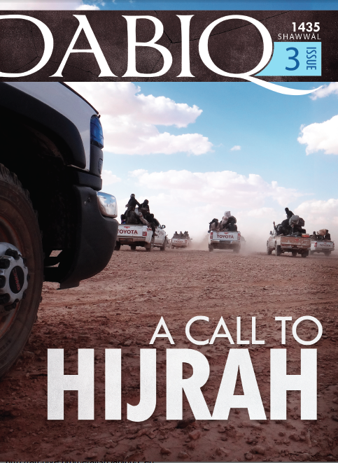
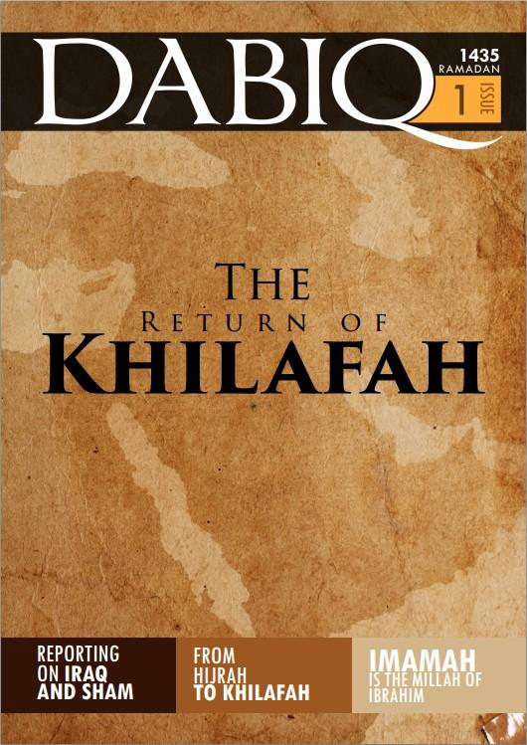
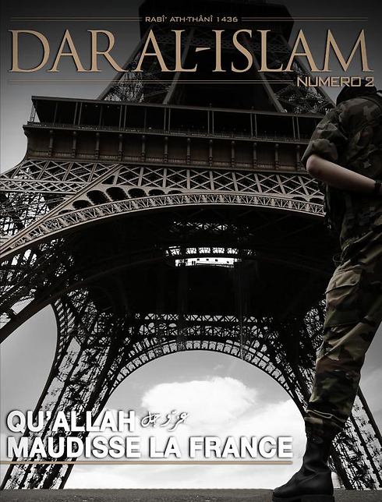

High-End Propaganda Magazines
Produced in French
Produced in English
Produced in Russian

Slide 5
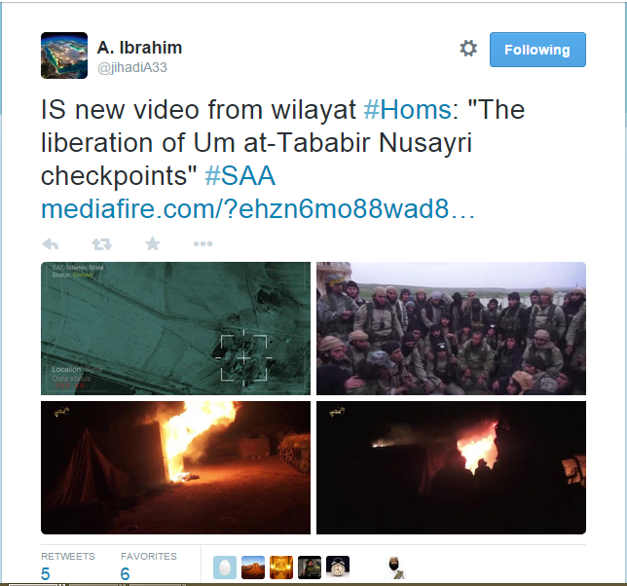
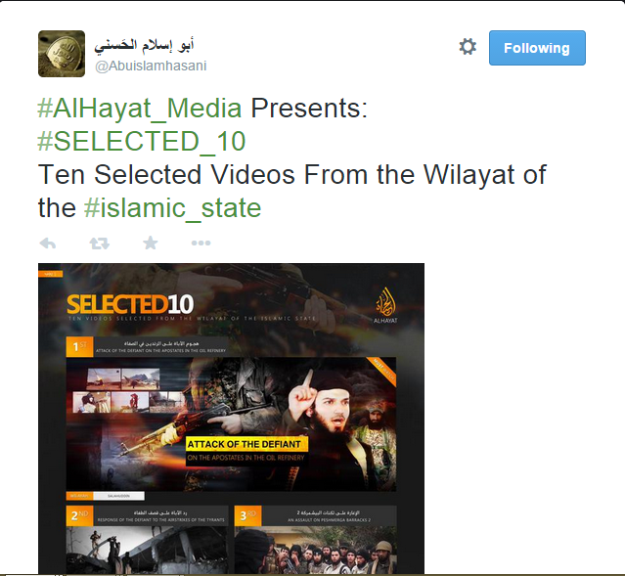
Social media: centralized messaging, decentralized distribution

Slide 6
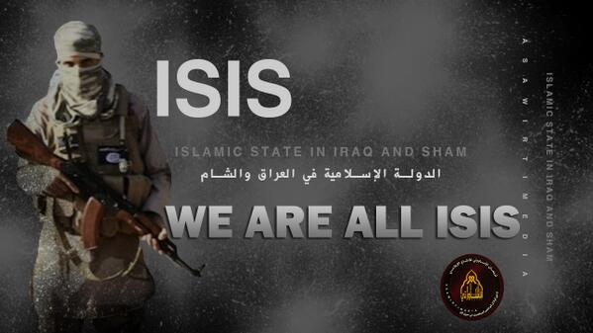

Marketing Jihad
“It’s not about ideals – 90% of them never subscribe to the ideals – it’s other factors that are a draw. This is the new rock and roll; jihad is sexy.”
Abu Muntasir, the “godfather” of the British jihadi movement.

Slide 7
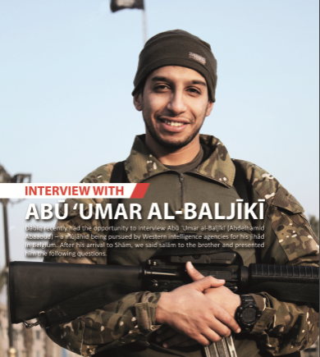
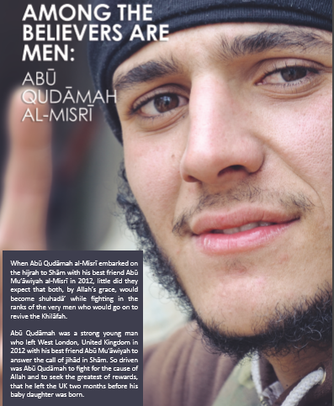
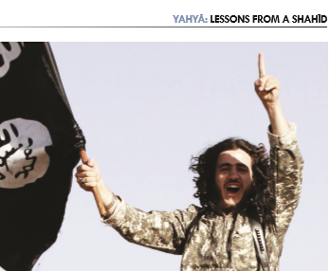
Jihadi Celebrity: from nobody to “holy warrior”
ISIS’ social media use glorifies jihad and martyrdom, allowing nobodies to become instant heroes.

Slide 8
Recruitment: How does it work?
“ISIL’s M.O. is to broadcast on Twitter, get people to follow them, then move them to Twitter Direct Messaging to evaluate if they are a legitimate recruit.”
  FBI Director James Comey
A long process: in the case of a Jordanian woman, 14 months.

Slide 9
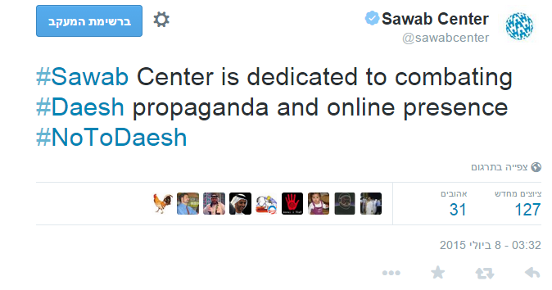

Fighting ISIS on Social Media
Promoting credible counter-narratives

Slide 10
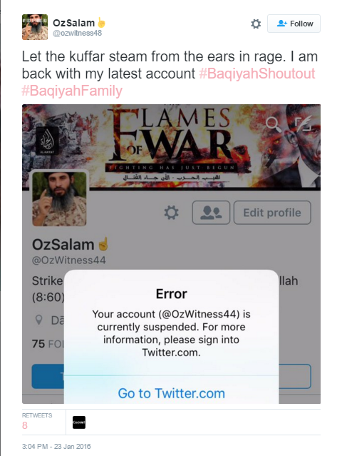
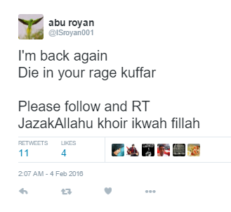
Fighting ISIS on Social Media
Since mid-2015, Twitter suspended 125,000 ISIS-affiliated Twitter accounts.
Such suspensions severely limit ISIS’ ability to spread their message and reach new audiences.

